Slide 1
Stream Analytics
Umamaheswaran
@UMW1990
Notes:
Coolest and Exciting
Relevant to programmers and data scientist
Managed, Cloud based, Constantly changing streams of data in real time
Under Azure Data Service
Combine stream and other services

Slide 2

The Internet of Things (IoT)
Currently 6+ billion devices connected to the Internet
By 2020, the number will grow to 50 billion or more
Power meters and health-monitoring devices
Wall thermostats, wind turbines and solar farms
Cars delivery trucks, traffic lights and drones
EVERYTHING will be connected
How do you process all that data?
How do you process it in real time?

Slide 3

Azure Stream Analytics
Highly scalable service for analysing data in motion
Analyze data streaming from IoT devices and other sources
Scales easily using streaming units (1SU ~= 1MB/sec)
Supports SQL-like query language for data analysis
Event Hubs
Event Hubs
IoT Hubs
Blob Storage
Power BI
Blob Storage
Other output sinks

Slide 4
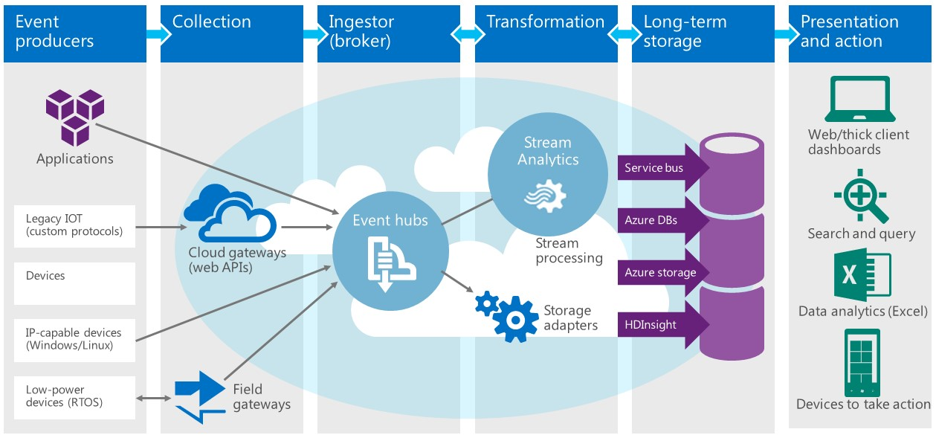
Azure Stream analytics at work

Slide 5
Stream Analytics Query Language
SQL like query language for querying live stream data streams
Subset of T-SQL
Supports bigint, float, nvarchar(max), datetime, record and array
Supports SELECT, FROM, WHERE, GROUP BY and other common data manipulation language (DML) statements
Supports COUNT, AVG, DATEDIFF and other common functions
Supports extensions such as TIMESTAMP BY and System.TimeStamp
Supports temporal grouping of events via “windowing”

Slide 6
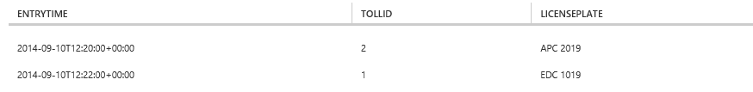
Querying a Data Stream
SELECT EntryTime, TollId, LicensePlate
FROM EntryData
WHERE Make = 'Honda' AND State = 'NJ'

Slide 7
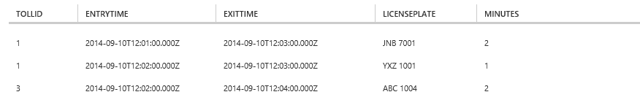
JOINing Two Data Streams
SELECT EN.TollId, EN.EntryTime, EX.ExitTime, EN.LicensePlate,
DATEDIFF(minute, EN.EntryTime, EX.ExitTime) AS Minutes
FROM EntryData EN TIMESTAMP BY EntryTime
JOIN ExitData EX TIMESTAMP BY ExitTime
ON EN.TollId = EX.TollId AND EN.LicensePlate = EX.LicensePlate
AND DATEDIFF(minute, EN, EX) BETWEEN 0 AND 15

Slide 8
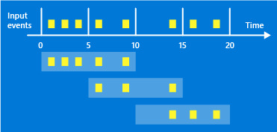
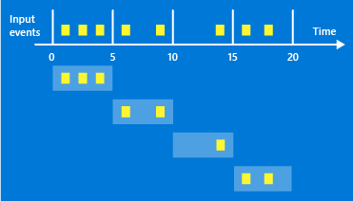
Windowing
Core requirement for stream-processing systems for counting or aggregating events in a specified time period
Tumbling Window
Hopping Window
Sliding Window

Slide 9
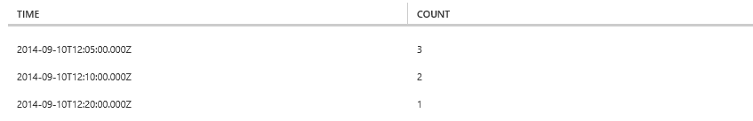
Using Tumbling Window
SELECT System.Timestamp AS Time, COUNT(*) FROM EntryData
TIMESTAMP BY EntryTime
WHERE TollId = 1 AND State = 'NY'
GROUP BY TumblingWindow(minute,5)

Slide 10
Using Sliding Window
SELECT DateAdd(minute,-5,System.TimeStamp) AS [Start Time],
System.TimeStamp AS [End Time], TollId, COUNT(*)
FROM EntryData TIMESTAMP BY EntryTime
WHERE State = 'NJ'
GROUP BY TollId, SlidingWindow(minute, 5)
HAVING COUNT(*) > 1

Slide 11
Demo
Create an event hub
Generate a shared-access signature token
Transmit events to the event hub
Create and configure a Stream Analytics job
Prepare queries and test with sample data
Analyze a live data stream

